Slide 1
Promises and Perils of Machine Learning:
A Real-world Evidence Fable
Wednesday, August 30, 2017
ICPE Montreal

Slide 2
Symposium Agenda
Introduction and overview of approaches
  Mary Beth Ritchey
Two examples
  Mary Anthony
  Niklas Noren
Methodological considerations of concept development
  Michele Jonsson Funk
Framework for review and comment
  Nabarun Dasgupta

Slide 3
Overview of the Continuum of Approaches
Mary Beth Ritchey, PhD
Principal Epidemiologist for Medical Devices, RTI Health Solutions

Slide 4
Disclosures - Ritchey
No specific funding was received for this project.
The following personal or financial relationships relevant
to this presentation existed during the past 12 months:
  Employment by RTI Health Solutions, a research institute that performs contracted services for pharmaceutical and medical
  device companies

Slide 5
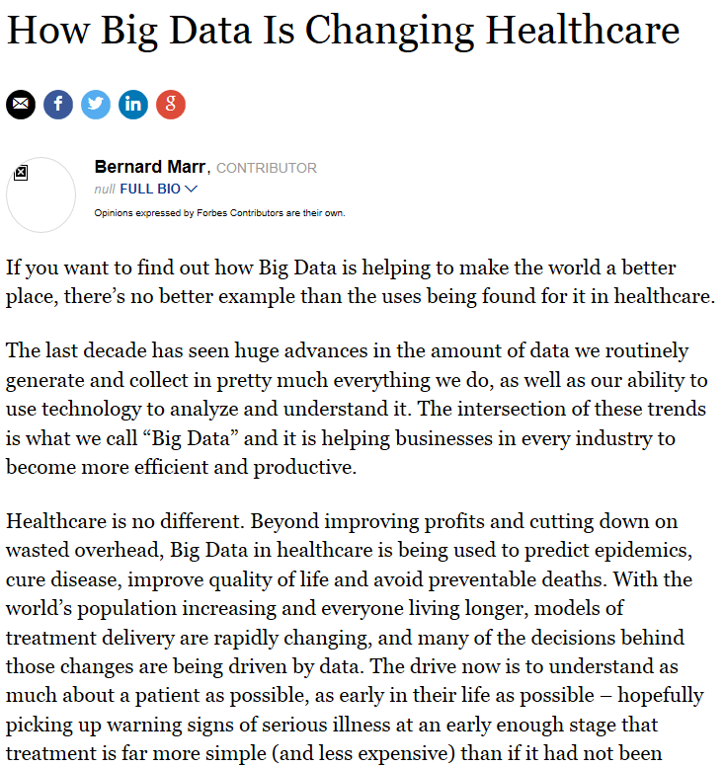
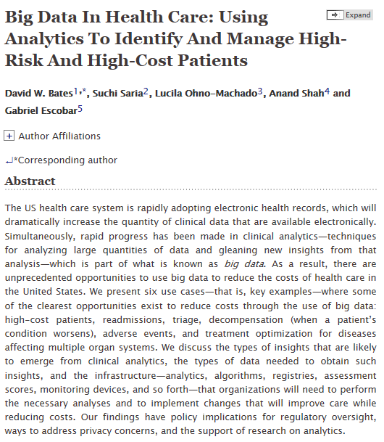
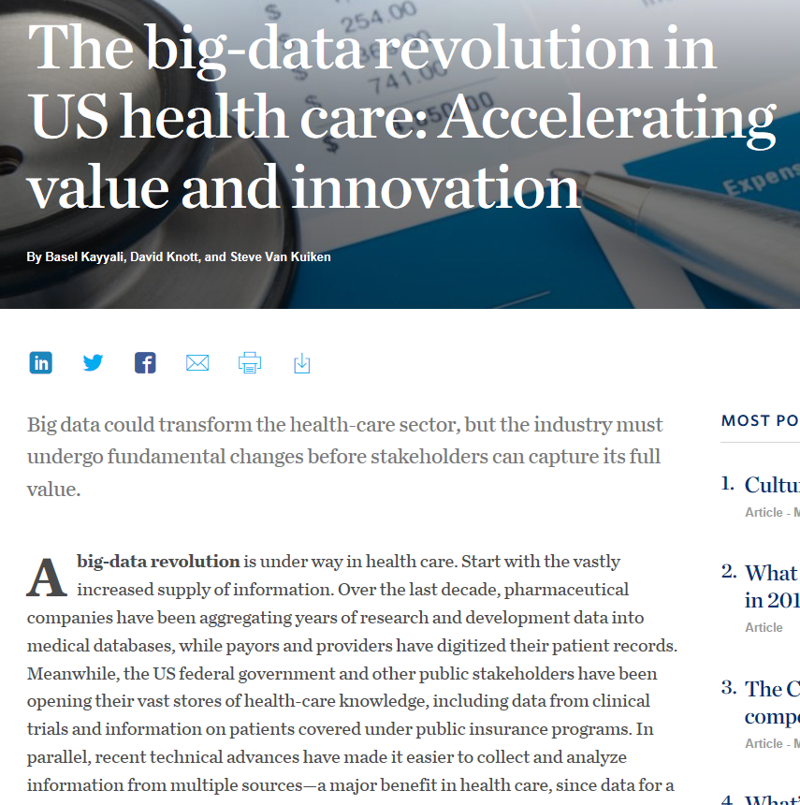
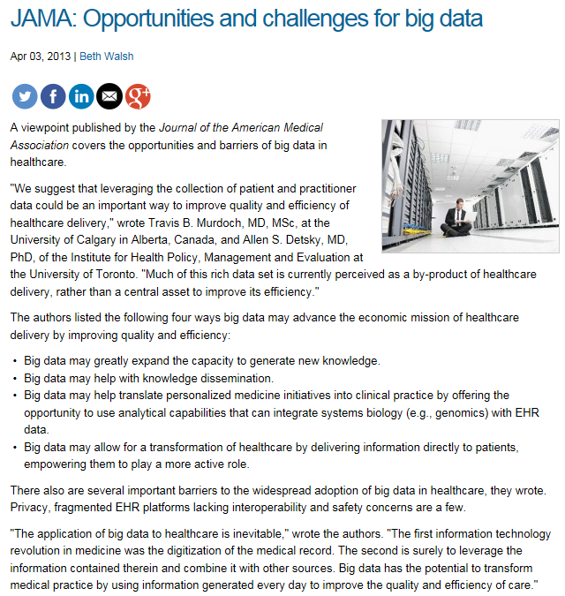

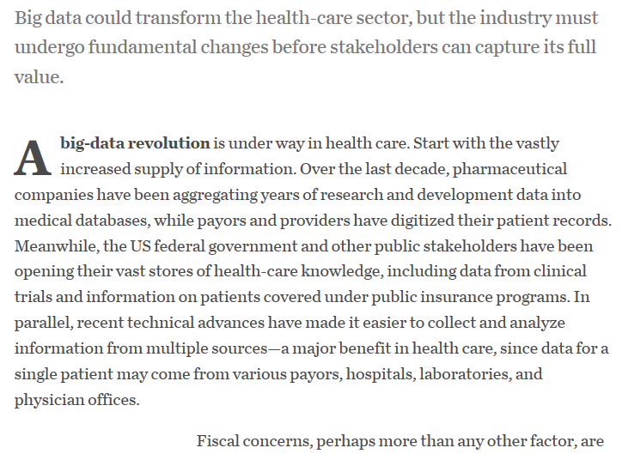
Big Data in Health Care
Sources: http://www.mckinsey.com/industries/healthcare-systems-and-services/our-insights/the-big-data-revolution-in-us-health-care; https://www.forbes.com/sites/bernardmarr/2015/04/21/how-big-data-is-changing-healthcare/#723a8e592873; http://www.clinical-innovation.com/topics/analytics-quality/jama-opportunities-and-challenges-big-data; http://content.healthaffairs.org/content/33/7/1123.abstract
Notes:
Cover: What is the purpose of “big data”?

Slide 6
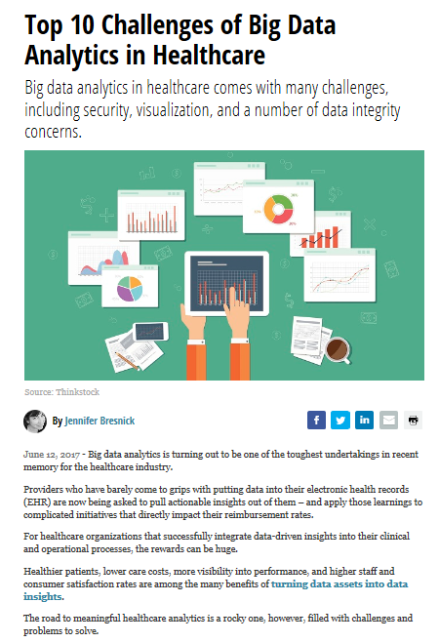
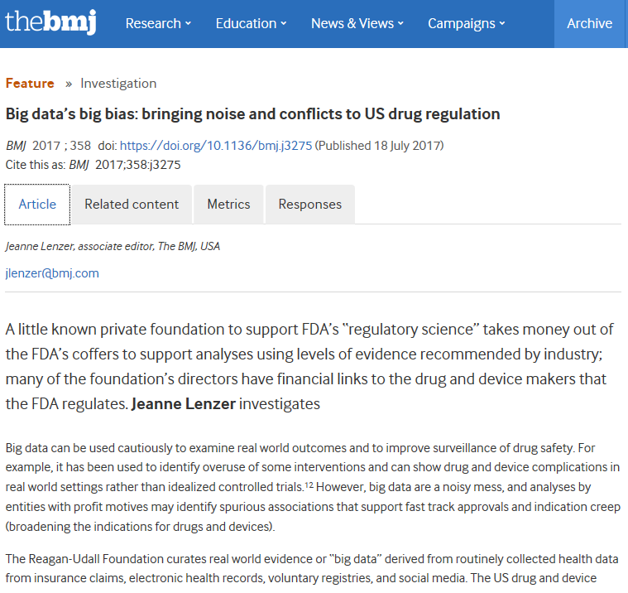
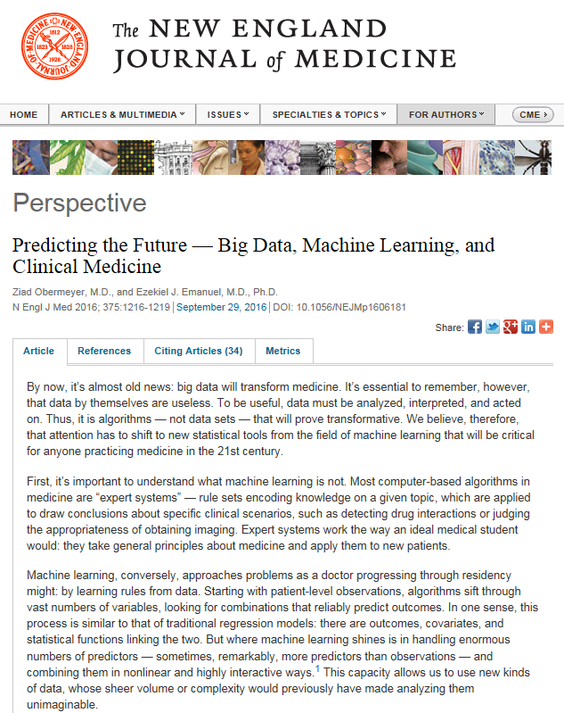
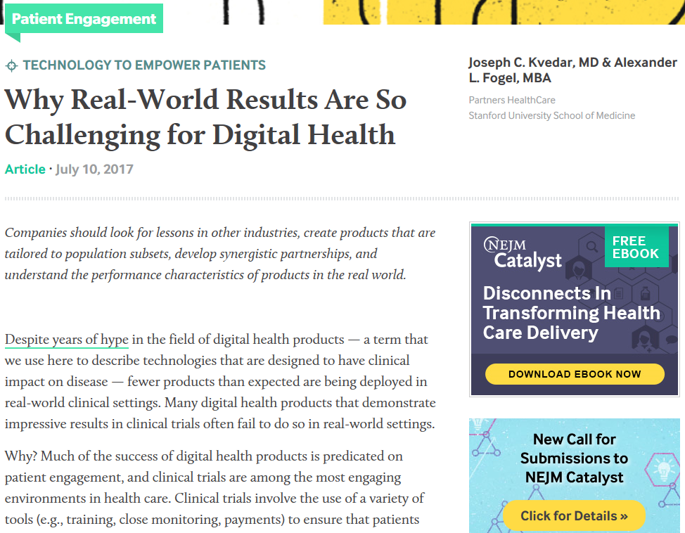
Caveats with Big Data in Health Care
Sources: http://catalyst.nejm.org/real-world-results-digital-health-products/; http://www.bmj.com/content/358/bmj.j3275; https://healthitanalytics.com/news/top-10-challenges-of-big-data-analytics-in-healthcare; http://www.nejm.org/doi/full/10.1056/NEJMp1606181

Slide 7
Barriers to Using “Big Data”
Patient protection
Data quality
Cost (monetary, time, resources)
Transparency
Disparate rules across stakeholders
Challenge for traditional peer review and publications
Where to start?
List adapted from source: http://www.nehi.net/writable/publication_files/file/rwe_issue_brief_final.pdf

Slide 8
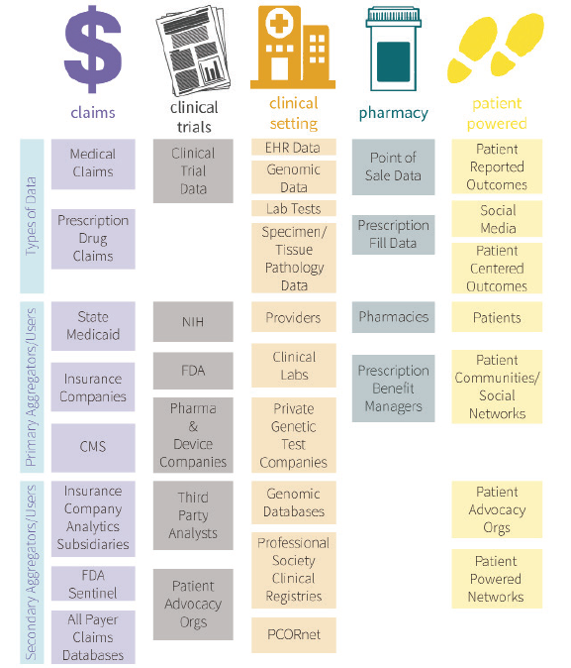
Data Sources
Data are generated and collected from multiple sources, aggregated and shared across health care system
In medical product epidemiology and vigilance, we use data sources collected for other purposes in order to assess utilization, safety, and effectiveness
Source: http://www.nehi.net/writable/publication_files/file/rwe_issue_brief_final.pdf

Slide 9
Types of Data
 | Structured Data | Unstructured Data
Characteristics | Pre-defined ontology Easy to search | Not pre-defined – may be text, image, sound, video Difficult to search
Examples | ICD-10-CM Read LOINC ATC MedDRA | Clinical notes Radiographs Social media Mobile health data
Adapted from source: http://www.datamation.com/big-data/structured-vs-unstructured-data.html

Slide 10
Continuum of Approaches
Code lists
Text/Audio/Visual Analytics
Predictive Analytics
Information extraction
Unsupervised Learning
Structured
Structured + Unstructured
Adapted from source: Gandomi A, et al. Beyond the hype: big data concepts, methods, and analytics. Int J Information Mgmt. 2015;35:137-44.

Slide 11
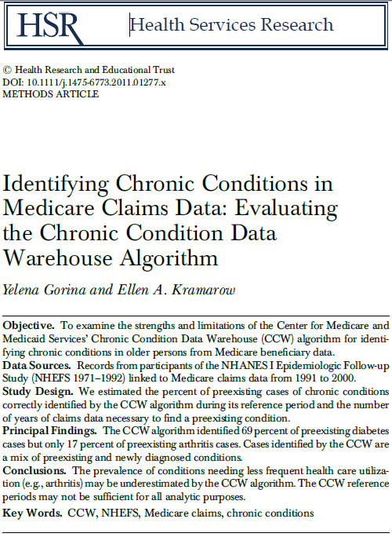
Years Studying Validity of Structured Data
Source: https://www.ncbi.nlm.nih.gov/pmc/articles/PMC3207195/pdf/hesr0046-1610.pdf

Slide 12
How can we use unstructured data?

Slide 13
Focus on Research Question
What do I want to learn?
  Exposures, outcomes, covariates
  Cross-section vs longitudinal data
When does this research need to be addressed?
  Timeframe within study
  Timing of results
Who wants to know?
Why is study needed?
Where are data coming from?

Slide 14
Example
Lifestyle Factors
Cardiovascular Outcomes
New T2DM Drug
T2DM = type 2 diabetes mellitus.

Slide 15
Continuum of Approaches
Ignore the variable for analyses
Use the data within the data source, despite misclassification
  Sensitivity analysis
Use proxy within the data source
Use information from an alternative source
  External adjustment
Integrate data from an alternative source

Slide 16
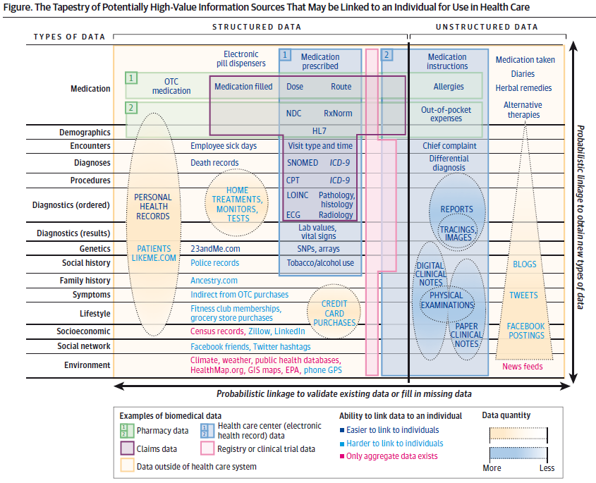
Where can we find needed data?
Within data source used to address research question
National surveys
Published literature
Clinical notes
mHealth apps
Social media
Source: Weber GM, et al., Finding the missing link for big biomedical data. JAMA 2014; 311(24):2479-80.

Slide 17
Continuum of Approaches
Ignore the variable for analyses
Use the data within the data source, despite misclassification
  Sensitivity analysis
Use proxy within the data source
Use information from an alternative source
  External adjustment
Integrate data from an alternative source

Slide 18

How do we use the data?

Slide 19
Structured Data – Code List Development
Generate list of terms/constructs for which codes will be needed
  Review with key study team members – achieve consensus
Generate list of codes for each term (for each coding system)
  Review with key study team members – achieve consensus
Incorporate codes into an algorithm
Validate algorithm (and assess reliability of algorithm across coding systems)
Update algorithm each time terminology changes
Anticipate changes in practice over time that will lead to changes in underlying data entry for some codes
Source: Quan H, et al., Coding algorithms for defining comorbidities in ICD-9-CM and ICD-10 administrative data. Med Care. 2005;43:1130-39.

Slide 20
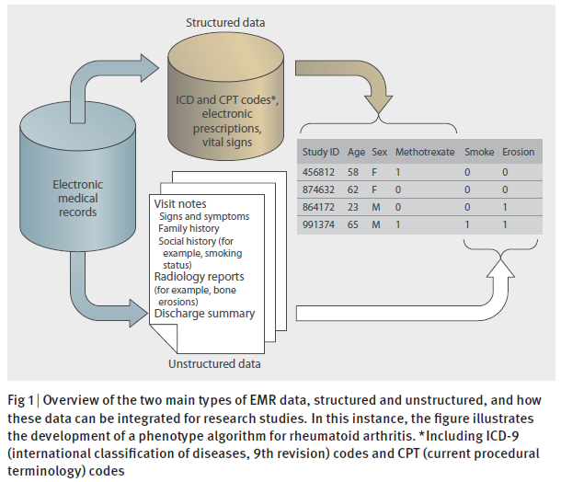
Unstructured Data – Natural Language Processing
Source: Liao KP. Development of phenotype algorithms using electronic medical records and incorporating natural language processing. BMJ. 2015;350:h1885.

Slide 21
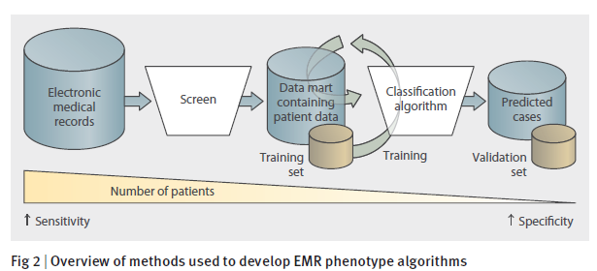
Unstructured Data – Natural Language Processing
Extract concepts from unstructured data
Develop algorithm incorporating structured and unstructured data
Curate to improve algorithm performance
Validate algorithm (stratified sampling or iterative approach)
Algorithm learning may be “supervised” or “unsupervised”
Source: Liao KP. Development of phenotype algorithms using electronic medical records and incorporating natural language processing. BMJ. 2015;350:h1885.; Upadhyaya SG, et al. Automated diabetes case identification using electronic health record data at a tertiary care facility. Mayo Clin Proc Inn Qual Out. 2017;1(1):100-110.

Slide 22
Let’s look at some examples…

